Slide 1
Ministry of Agriculture and Irrigation Seminar on the Role of Private Sector for Sustainable Myanmar Rice Sector and Seed Industry Development Policy Support for Increasing Private Sector Investment in Sustainable Rice Sector and Seed Industry Development
Tin Htut, Ph.D Permanent Secretary
18 March 2016
Nay Pyi Taw

Slide 2
Outline
1
Overview
Existing Sectoral Development Policies, Strategies and Law
2
3
Public-Private Partnership
4
Value Chain of Seed Industry
5
Continuity and Way Forward

Slide 3
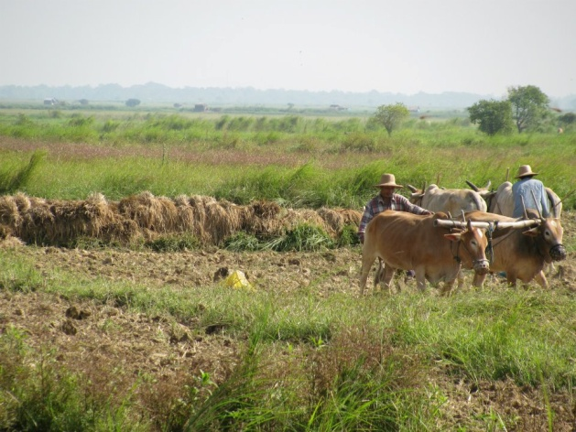
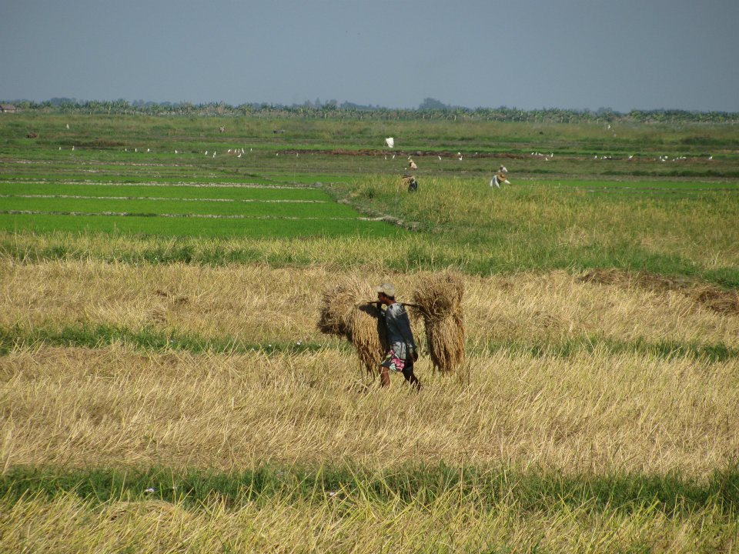
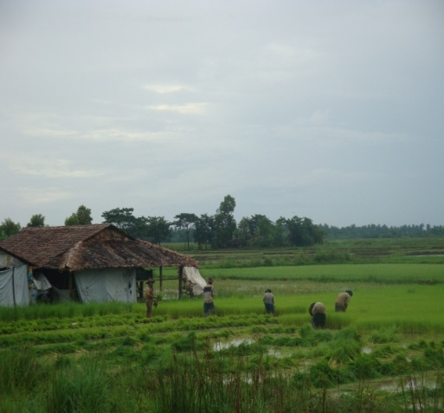
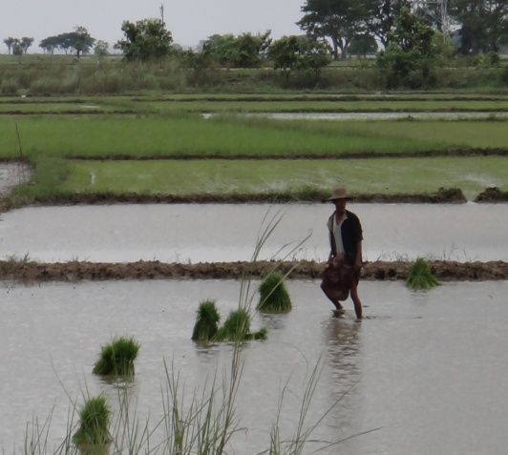
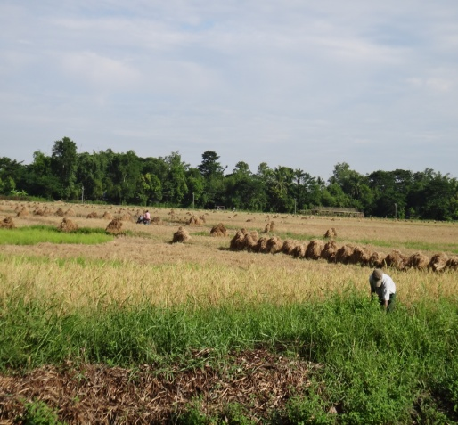
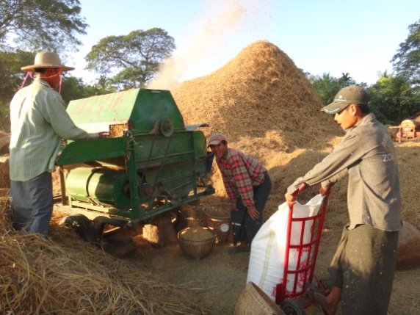
Overview
Rice underpins rural livelihoods
About 70% of the population depend on rice to live
Majority are smallholders and resource poor
Improving rice production offers an opportunity to their better livelihoods
Rural Economy is Rice Economy
Rice Economy starts with good quality seeds
Seed security leads to food security (At the time of crisis)
Time for change is time for seed
M

Slide 4
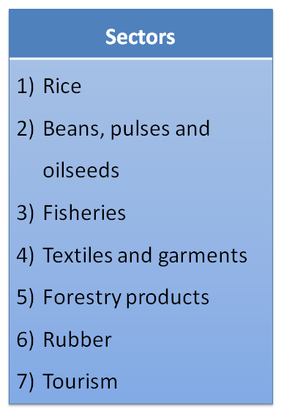
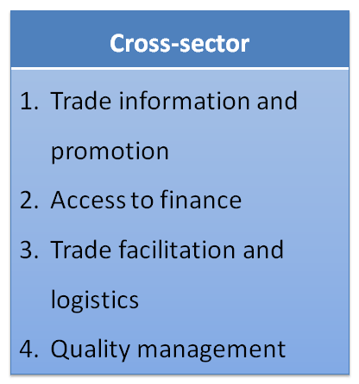
National Export Strategy
2013-2014: Development of the Myanmar National Export Strategy
Analyses of important economic sectors in Myanmar with high export potential
Analyses of the 'bottlenecks' hampering this export potential to come to full growth.
March 2015: Official launch of the Myanmar National Export Strategy by Vice president of Myanmar
Result: 7 sectors + 4 cross sector topics identified that will get priority focus in order to enhance Myanmar's export.
Notes:
2013-2014: Development of the Myamar national export strategy
Analyses of important economic sectorsin Myanmar with high export potential
Analyses of the 'bottlenecks' hampering this export potential to come to full growth.
March 2015: Official launch of the Myanmar national export by Vice president
Result: 7 sectors + 4 cross sector topics identified that will get priority focus in order to enhance Myanmars export.

Slide 5
Agribusiness Potential of Myanmar
Increase Productivity of farming sector worth additional $3bn GDP by 2023 (Agri-business value chain PPTA Report, ADB estimation, 2016)
Focus competitive advantage by Rice, Pulses, Groundnut, Sesame
Commodity | Global Rank by Volume | Production (000 tons) | Share of total global production | Share of domestic agricultural output
Rice | 7 | 28,000 | 3.8% | 30%
Pulses | 3 | 5,400 | 7.5% | 15%
Groundnut | 6 | 1,400 | 8.1% | 5%
Sesame | 1 | 890 | 18.7 | 6%

Slide 6
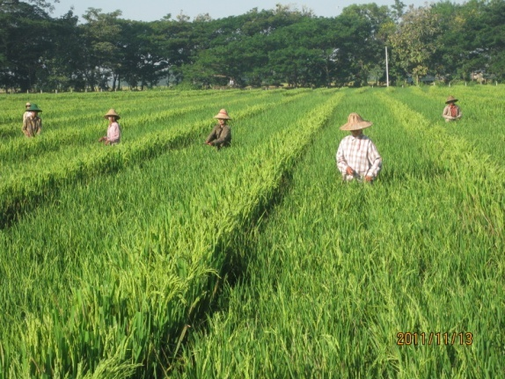
The Vision and Goal of Myanmar Rice Sector (Vision 30:30) (MRSDS)
Vision
“Food-secure farmers and consumers enjoying the economic benefits provided by a transformed, dynamic and internationally competitive rice sector that produces rice using sustainable farming practices and effective resource management by 2030”
Goal
“ To achieve a food-secure society and for smallholder farming households in rural areas to triple their income derived from rice and rice-based farming and enjoy decent standards of living”

Slide 7
Actions to achieve the Vision by 2030
Three main actions suggested to achieve the Vision;
Increase investment in capacity building, research and development and extension
Increase investment in rural infrastructure
Institution and policy reforms and innovations

Slide 8
Projection of Paddy Production and Surplus of Rice for the years 2020-2021 and 2030-2031
Year | Sown area (Mil Ha) | Yield (MT/ Ha) | Paddy Producti-on (Mil MT) | Popu-lation (Mil) | Rice consump- tion (Mil MT) | Seed & rice loses (Mil MT) | Surplus rice (Mil MT)
2012/13 | 7.24 | 3.84 | 27.70 | 50.92 | 8.91 | 1.11 | 6.59
2020/21 | 7.59 | 3.90 | 29.60 | 55.03 | 9.90 | 1.15 | 6.73
2030/31 | 7.70 | 4.10 | 31.57 | 60.67 | 9.55 | 1.15 | 7.84

Slide 9

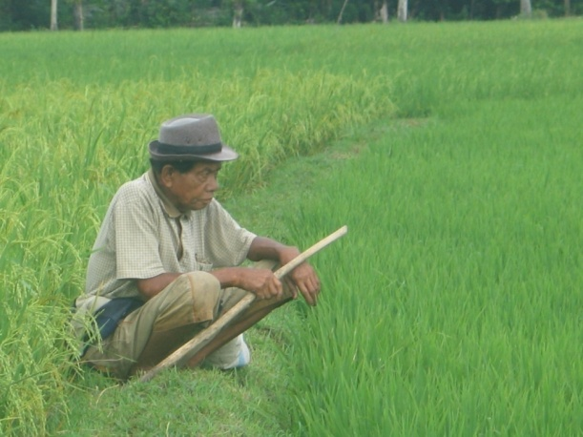
From rice for poverty to rice for prosperity…

Slide 10
National Production of Paddy

Slide 11
Total rice exports – calendar year (milled equivalent), 1991-2014
Source: FAOSTAT (1991 to 2011); FAO estimate (2012); Central Statistical Organization, Ministry of National Planning and Economic Development (2013 to 2014)

Slide 12
Rice Export of Myanmar (Thousand Metric Ton)

Slide 13
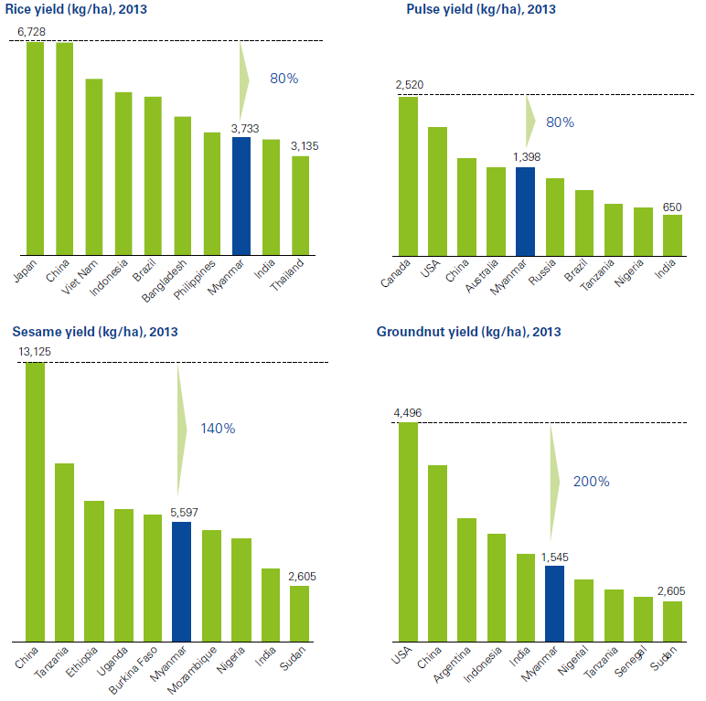
Rice Yield (ton/ha) 2013
Source: Agri-business value chain PPTA Report, ADB estimation, 2016

Slide 14
Rice Productivity and Trade Potential
 | Milling Efficiency | Shipping cost $/20,000 tonne vessel | Export license cost $ per tonne
Myanmar | 60% | 145000 | 8.59
Viet Nam | 63% | 65000 | 0.05
Thailand | 66% | 60000 | 0.10
China - Korea | 70-75%
Source: Agri-business value chain PPTA Report, ADB estimation, 2016

Slide 15
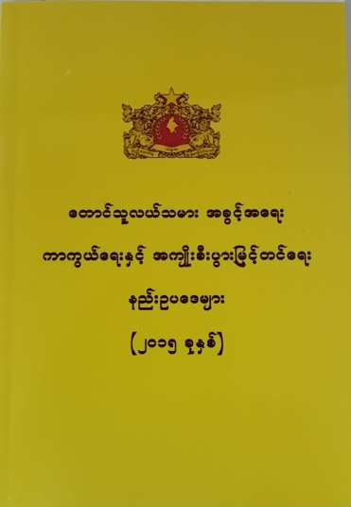

Overarching Law for Agricultural Development
The Regulations of Protection of the Farmers Rights and Enhancement of their Benefits (2015)
The Law of Protection of the Farmers Rights and Enhancement of their Benefits (2013)

Slide 16
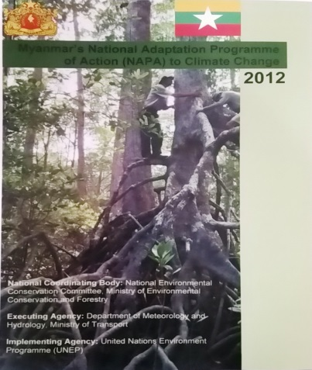
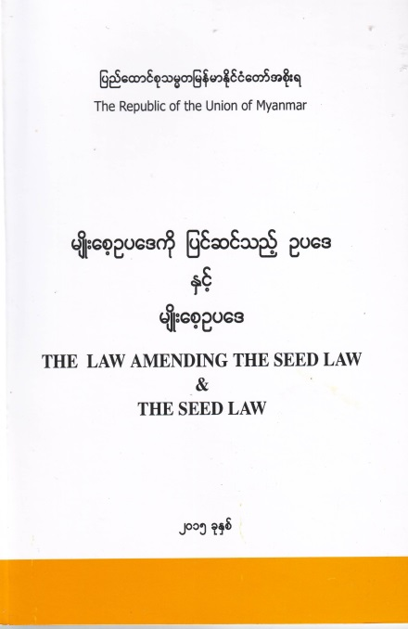
Existing Sectoral Development Policies, Strategies and Laws
Rice Sector Development Strategy
Climate Smart Agriculture Strategy
Plant Pest Quarantine Law
The Seed Law
Farm Land Law
Plant Varietal Protection Law
Law on Bio safety (Draft)
Pesticide Law
Fertilizer Law
Vision for Food, Agriculture and Forestry 2025
National Adaptation Program of Action to Climate Change

Slide 17
Major Stakeholders
Government/ Ministry
- Policy makers/Law Makers
- Planner
- Research Institutions
Extension/ Agricultural Advisory Service
- Private
- Local and Foreign Investors
Traders
Civil Society Organization
Farmers Organization
NGO/INGO
International Organization (IRRI, ADB, WB, IFAD)

Slide 18
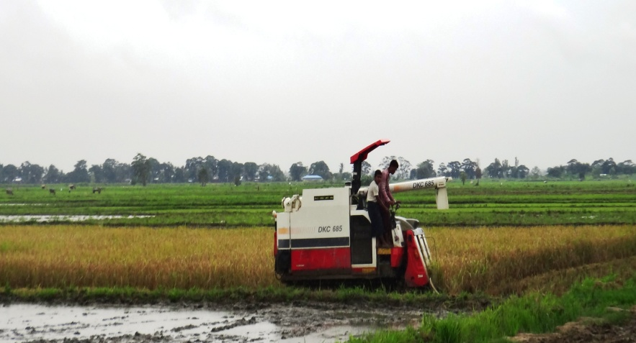
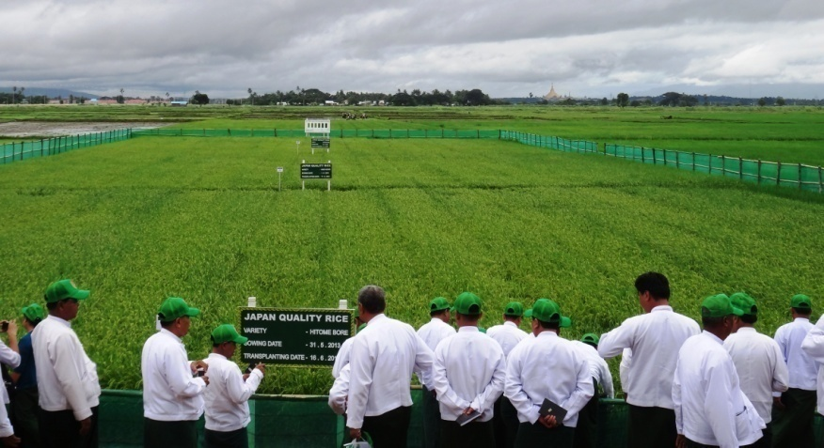
Strategy towards “Rice for Prosperity”
Use of improved quality of seeds
Establishment of model farms
Timely and effective utilization of inputs
Reduction of production and post-production losses
Strengthening access to markets
Source: Madona Casimero, 2014

Slide 19
National Seed Policy (Draft)
MOAI with the assistance of FAO formulated a National Seed Policy in 2013
Support the establishment of a sustainable seed industry
Assure access of farmers to quality and improved seeds of high yield crop varieties
Indicate the need of more investment and focused effort to promote the sector and recognize the complementarity between the public and private sector
Mass utilization of quality seeds towards enhancing the status of the private sector as the main conduit for commercial seed business

Slide 20
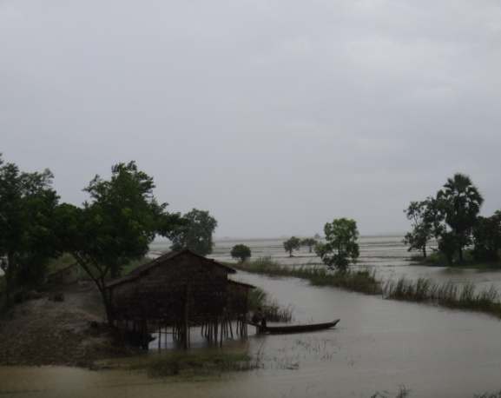
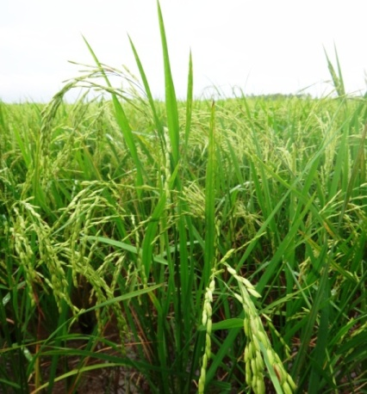
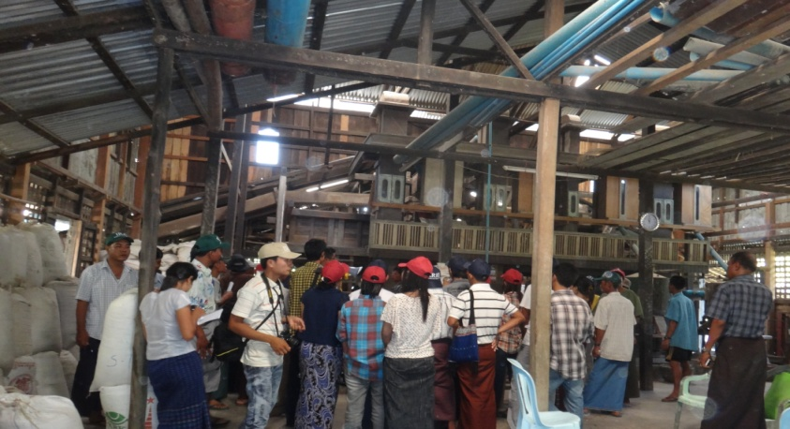
Principal Challenges for Knowledge Intensive Rice Farming System and Developing Value Chain
Technology
Investment
Market

Slide 21
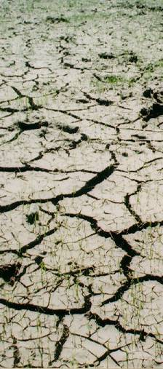
Additional Challenges
Less land
Less water
Less labor
Climate change

Slide 22
Strategies to Transform Rice Productivity in Myanmar (Source: Rice productivity Improvement in Myanmar, Background Paper No.2, USAID, Michigan State University and MDRI, 2013)
Short Game
Understanding the resource base
Documenting ways to improve farm- level productivity
Demonstrating change
Long Game
University development outreach corps
Myanmar Rice Research and Development Center
Transformative Extension Service

Slide 23
Strategic Options for the Long Game (Source: Strategic Choices for the future of Agriculture in Myanmar, MSU & MDRI/CESD)
Food System Components | Long Game Early Actions | Long Game Reforms
Farming | 1.Agricultural sector budget and institutional review 2.Agricultural graduate deployment(UDOC) 3.Land policy monitoring and support 4.Access to micro-irrigation for farmer organizations 5.Climate change and water control assessment | + budget resources for agriculture + institutional reform (agricultural research, extension, education) + land access + farmer organizations + water system management

Slide 24
Strategic Options for the Long Game
Food System Components | Long Game Early Actions | Long Game Reforms
Post-farm value chain | 6.Upgrade agricultural statistical systems 7.Rural cell phone expansion 8.MADB assessment | +improve data quality +predictable policies(land use, input quality, trade) +rural finance +intermodal transport system logistics
Landless and near landless | 9.Pilot efforts to improve enrollment, curriculum and nutrition | +education reform + rural nutrition, health and sanitation

Slide 25
Strategic Options for the Short Game
Targets | Short Game Early Actions | Short Game
Farming a)Improve productivity of monsoon rice b)Promote dry season and Dry Zone diversification | 1.Summarize best practices and economics of alternate cropping systems 2.Assess lessons from elsewhere on promotion of high value activities for vulnerable groups | +agronomic practices +seed quality +farm-level water management +diversification: high-value scalable(horticulture, poultry, fish ponds)
Post-farm value-chain | 3.post-harvest loss assessment | +post-harvest handling +target niche markets

Slide 26
Strategic Options for the Short Game
Targets | Short Game Early Actions | Short Game
Landless and near landless | 4.Pilot programs promoting school Attendance, improved nutrition and health(link with high-value diversification) 5.Test pilot safety nets to reduce indebtedness following livelihood shocks | + high value agriculture + nonfarm income + education access + nutrition package(horticulture, poultry, education, public health) +scale up safety nets an insurance options for landless households

Slide 27
Functions of Public Sector in Seed Industry Development
To implement in technology transfer, raising seed technologists, upgrading existing capacity of seed staffs and formulation of rules and regulations.
Field inspection teams for seed quality control should be formed in each state and region.
The functions of National Seed Committee should be reactivated
The necessary logistic and infrastructure of existing seed processing plants should be renovated to operate the machines with full capacity.
Technical support and required registered seeds should be provided to private sector by the state sector in production of certified seeds
Trainings and public awareness program should be conducted by department concerned to follow rules and regulations of the Seed Law
Strengthening breeding program in DAR, collaborating with International research institutions
Plant Varietal Protection Law to protect the breeder rights and improve capability of the researchers
Required budget should be allowed to expand the research activities

Slide 28
Functions of Private sector in seed industry development
Establish seed storage facilities and seed testing laboratories in standard form
Seed production procedures prescribed at each stage must be followed
Imported new varieties must be registered according to the existing seed law
Strict adherence of procedures by private sector seed technicians in seed production.

Slide 29
Public-Private Partnership
Public Sector
Establish a seed certification system and valid quality control mechanisms
Not sufficient processing facilities to clean seeds, thus rendering policies that mandate high quality mute.
Old processing plants, are poorly functioning due to a lack of maintenance and operational funds.
Government investment should focus on quality control to upgrade seed testing facilities to enable them to enforce the standards set out in the Seed Law.
Private Sector
Can invest and renovate Processing facilities.

Slide 30
Perspective from Demand and Supply Sides for low use of Certified Seed (Source: Francesco Goletti, 2014)

Slide 31
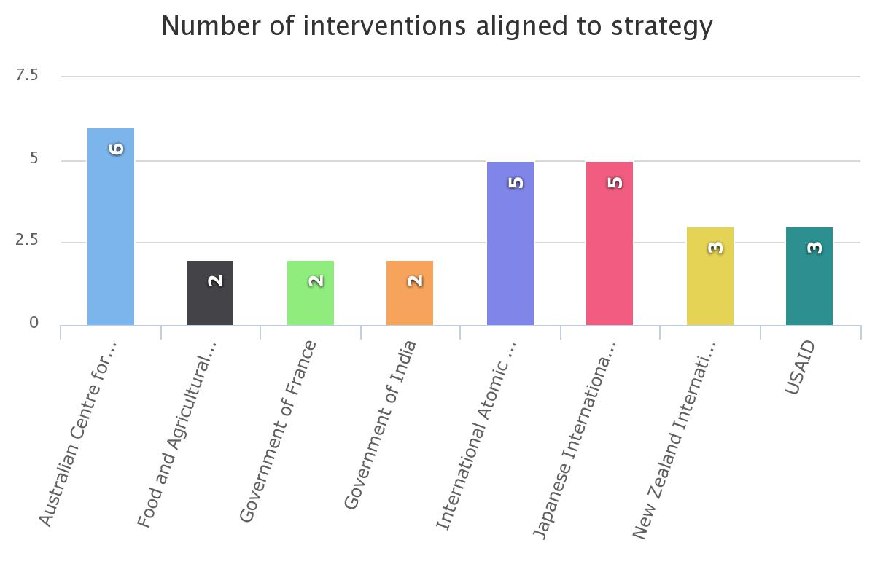
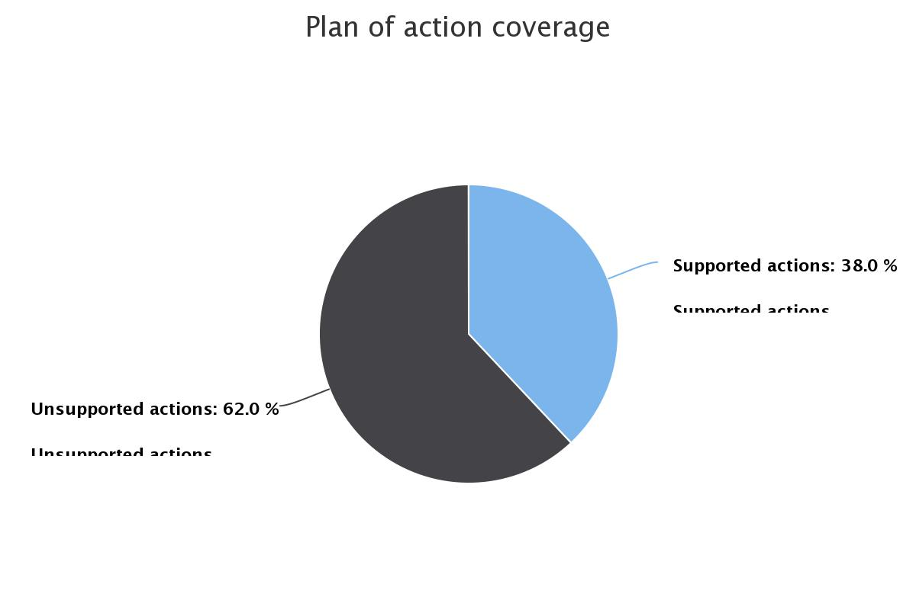
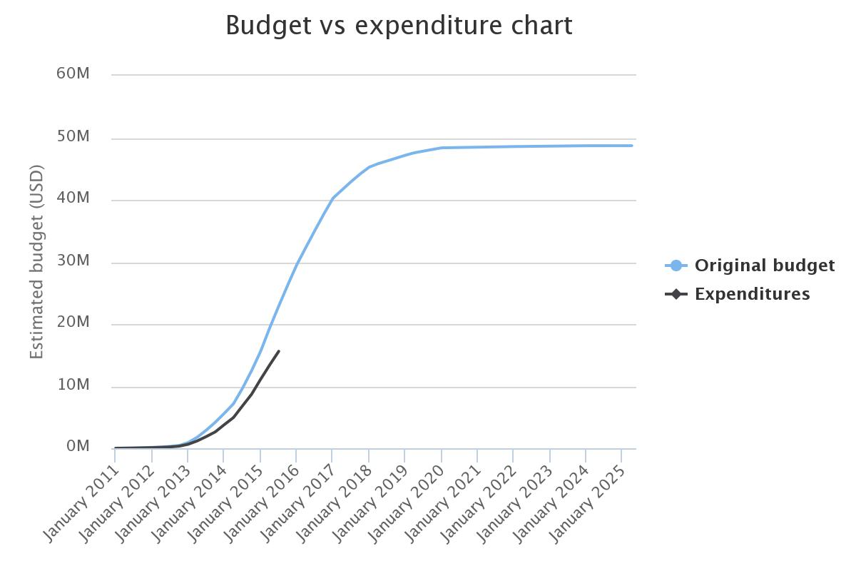
Sector specific support – Rice (Ministry of Commerce, 2015)
38% of activities from rice strategy receives direct or partial support
Most active donors- Australian Centre for International Agricultural Research, International Atomic Energy Agency and JICA.
Estimated delivery of project is on track with large increase of resources in the next few months

Slide 32
Types of Seed Systems
Formal seed systems
Government institutions, DAR, DOA
Private sector companies
International organizations, IRRI
2. Informal seed systems
Farm saved seed
Agro Dealer
Local markets
Relatives/Friends
Seed Aid

Slide 33
Figure: Seed Sources for Main Crops (FAO- WFP-CFSAM, 2016)

Slide 34
Value Chain of Seed Industry in Myanmar
DAR
Breeder Seed
Foundation Seed
DOA
Register Seed
Certified Seed
Imported Hybrid Seeds
CONTRACT FARMERS
PRIVATE COMPANIES
FARMERS
Value Chain
Seed Production
Seed Distribution

Slide 35
Rule and Regulation of Seed Distribution
Seed registration
- Variety testing and Evaluation
- TSC (Technical Seed Committee)
- NSC (National Seed Committe)
- Approval of NSC
- Commercial Release of New Variety

Slide 36
Strength, Weakness, Opportunities and Threats in Development of Seed Industry
Strengths | Weaknesses
Abundant plant genetic resources Diverse agro-ecological and environmental conditions Seed Law – already in place Network of research and seed production(24 rice research stations and 32 seed farms), Existing supply chain in place: Public, private and farmers Private Sector is involving in seed production, distribution and marketing Strong coordination between public and private sectors in production of seed The contract farming system is well functioning in seed production Strong political will | Insufficient budget for R&D Less infrastructure in public sector for seed production Low Human Resource Development (HRD) Poor facilities in seed quality control and management, Lack of National Seed Policy Weakness of public awareness on Seed Law and regulations Poor marketing information acess, Lack of diversification: mainly focus on rice, maize and vegetables, Lack of incentives to private sector to invest in seed industry

Slide 37
Strength, Weakness, Opportunities and Threats in Development of Seed Industry (Cont’d)
Opportunities | Threats
Abundant of land, water and labor resources Co-operation with international research institutions Public Private Partnership (PPP) is improving Increasing farmers’ awareness for improving crop productivity Increase of private investment in seed production Increasing demand for certified seeds. Foreign Investment in seed industry is being initiated, | Negative impact of Climate Change Cultivated land area declines by industrialization Weakness in quarantine procedure in importing seed and plant parts across border Lack of services sector in prevention and control on incidence of pests and diseases Illegal and informal border trade with neighboring countries

Slide 38
Key Issues and ways forward for establishment of Myanmar’s Seed Industry (Ms.Tin Tin Myint, DAR)
Policy Constraints
Need of concrete policies for sectors, crops, varieties with priorities
Intellectual properties rights not well defined
Need of market-driver policy
Need of clear policy on variety accreditation and registration
Insufficient budget allocation to Research and Development
Credit provision to producers for seed production

Slide 39
Institutional Development
Laws and regulations (seed law, PVP law) from local government to grass-root level
Needs to promote capacity building (Institution, HRD)
Establishment of seed industry associations
Seed certification system enhancement
Community seed bank, farmer groups and seed accreditation
Institutionalization of farmers participatory seed development and production
Strengthen International collaboration for Research and Development

Slide 40
Infrastructure and Facilities
Advanced seed and grain quality laboratory
Rural infrastructure
Equipment: Advanced equipment for plant physiology
Molecular DNA laboratory
Seed health
Post harvest Facilities

Slide 41
Continuity and Way Forward
A more harmonized public and private partnership
Enactment and Enforcement of regulations stipulated in the Seed Law
Awareness of the rules and regulation by the Private Seed Companies
Still important roles for the public sector to improve agriculture and to support a private sector led seed system
Transforming towards stronger/functional extension network (pluralistic extension)
Scaling out and scaling up
System main streaming and streamlining
Strategy into action plan/inclusive rice sector

Slide 42
Thank you very much for your kind attention.

